Slide 1
SCOTUS Staff Training Toolkit
Updated: September 2024

Slide 2
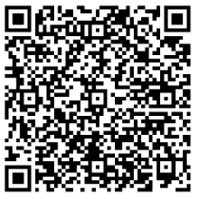
Summary
Following the 2023 SCOTUS ruling, which prohibits considering racial status in the admissions process to advance diversity goals like those Harvard and UNC asserted, College Board’s Access and Diversity Collaborative (ADC) highlighted the need for new resources to support admissions staff training.
Eleven ADC sponsor institutions shared their current training practices, and we have distilled the key insights into a practical, action-oriented summary of effective practices.
Access this
toolkit virtually

Slide 3
Recommended Actions and Practices

Slide 4
Continuous training on application review and evaluation
01
Continuous Training
Continuous training is essential for effectively reviewing and evaluating applications:
Primary Training: Typically takes place in the fall prior to application reviews. A large flagship public institution noted that they begin training their new admission staff and interns in early summer so they’re already familiar with the information when full staff training starts in fall.
Regular Check-Ins: Establish opportunities throughout the application review season to allow staff to answer questions, identify trends they may be seeing, and ensure everyone is on the same page.
Comprehensive Training Methods: Incorporate homework including mock application review, readings, group work, and a final assessment to ensure thorough understanding.
02
Bias Training
03
Managing Application Review
04
Anticipate Questions

Slide 5
Incorporate bias training into staff training
01
Continuous Training
Bias training is an integral part of application evaluation training:
Include Internal and/or External Experts: Some institutions rely on internal experts for bias training, while others bring in external specialists. Many use a combination of both, depending on their needs.
Leverage University-Wide Trainings: One selective institution in the South requires bias training for all employees and students, so the admissions office doesn’t implement additional training.
02
Bias Training
03
Managing Application Review
04
Anticipate Questions

Slide 6
Determine who gets to view applicants’ racial status and when
01
Continuous Training
There are mixed strategies on whether staff see applicants’ racial status on the application:
State Bans Pre-2023 Ruling: Some ADC sponsor institutions in states with previous bans on race-conscious admission chose to suppress applicants’ racial status on the application.
Post-2023 Ruling: Following the 2023 ruling, other ADC institutions have also decided not to allow staff and readers to see applicants’ racial status during the review process.
Data Collection: The ruling did not specifically address data collection or require institutions to suppress or remove racial status from applications. U.S. Department of Education Post-SFFA guidance advised that suppression of an applicant’s racial status from view of file reviewers and admissions staff involved in selection was warranted.
02
Bias Training
03
Managing Application Review
04
Anticipate Questions

Slide 7
Be prepared for questions
01
Continuous Training
Questions from staff and their understanding of the ruling may vary based on experience level:
Common Concerns: Many ADC sponsors noticed that the most common questions from staff are centered around correctly following the law while evaluating applications.
Application Review Notes: A highly selective institution in the Midwest shared that many staff grapple with writing notes that don’t appear to consider racial status when students talk about race as part of their live experience within their application materials.
Experience Level Differences: Some ADC sponsors indicated they see a difference in the level of understanding of the ruling from their entry-level and senior staff. For example, a selective mid-Atlantic institution shared that their junior staff often present questions about the “gray area” and the ruling’s impact on the profession, reflecting their developing admission experience. Conversely, a private institution in the South found that seasoned staff presented questions due to their familiarity with previous processes, while newer staff had fewer questions as the application evaluation process was new to them.
02
Bias Training
03
Managing Application Review
04
Anticipate Questions

Slide 8
How to use this content

Slide 9
Then to Now: A history of race-conscious admissions policies
For admissions and enrollment professionals, especially those new to the field, to understand the history leading up to the 2023 ruling. Can also be shared with external application readers. Links to summaries of each court case in the timeline are provided.
The 2023 SCOTUS Ruling in a Nutshell
To help all staff understand the ruling and its implications. A short read, this can serve as a primer for discussions about the 2023 ruling.
Additional Ruling Guidance and Insight
Addresses questions about the ruling’s impact on Native students, linking to the Department of Justice/Department of Education’s guidance document.
Resources to Inform Next Steps
Highlights 2 ADC webinars from 2024 discussing the ruling’s implications a year later and offering race-neutral strategies for admissions. Each recording is about 60 minutes, with key presentation slides referenced.
ADC Sponsor Examples
Provides examples of how other institutions train their staff in response to the ruling, including timing, training for internal staff versus external readers, and training methods.
Features insights from a panel at College Board’s 2023 Forum, including myths about the ruling, advice for K12 counselors, institutional goals, recruitment, outreach; and long-term planning. Recommended discussion questions are provided.

Slide 10
Then to Now: A History of Race-Conscious Admission Policies

Slide 11
Four Decades of Legal Precedent
Then to Now: A history of race-conscious admission policies

Slide 12
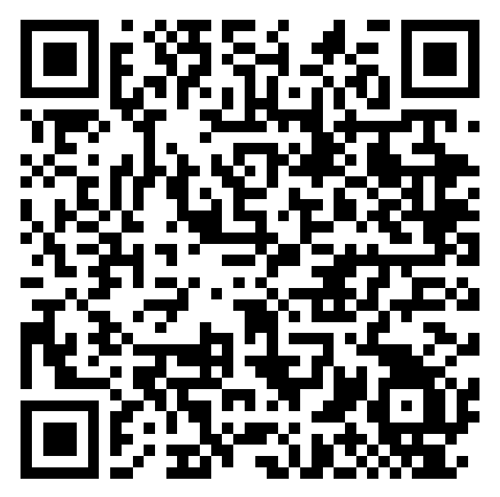
Bakke (1978)
In 1978, the U.S. Supreme Court ruled that the use of quotas for admission purposes was unconstitutional and struck down the University of California Davis’ Medical School admissions policy that provided a set-aside for underrepresented minority students.
At the same time, Justice Powell’s opinion opened the door to institutions being able to consider an applicant’s race as one factor among many to advance diversity interests.
Admissions and Diversity After Michigan: The Next Generation of Legal and Policy Issues
https://rb.gy/065hvf

Slide 13
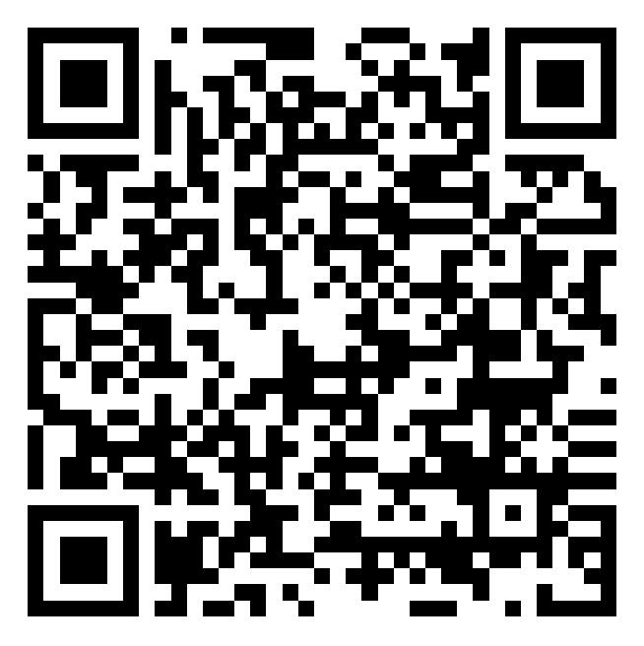
Grutter and Gratz (2003)
In 2003, the United States Supreme Court’s Grutter v. Bollinger and Gratz v. Bollinger decisions affirmed that the educational benefits of diversity could justify limited race- conscious admissions practices and, as a consequence, generated a renewed focus on both the means and ends associated with higher education’s diversity-related goals. The Court upheld the University of Michigan’s law school policy but struck down it’s undergraduate admissions policy in these cases.
When the Supreme Court first ruled on affirmative action
https://rb.gy/yujtpv

Slide 14
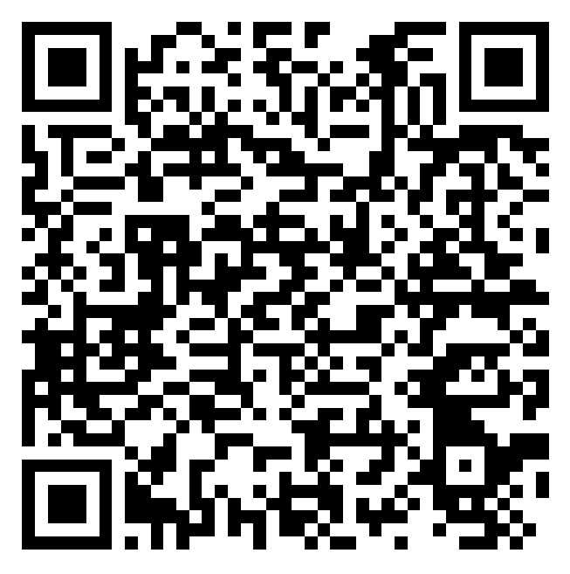
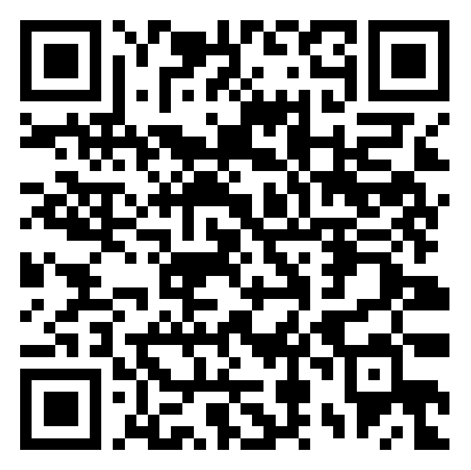
Fisher I and Fisher II (2013, 2016)
On June 23, 2016, the U.S. Supreme Court’s second decision in Fisher v. University of Texas at Austin upheld the University of Texas’s race-conscious admissions program under federal law following a decision that established new requirements regarding race-neutral practices.
Understanding Fisher v. University of Texas
https://rb.gy/vbofsb
Implications from Fisher II
https://rb.gy/4u2bil

Slide 15
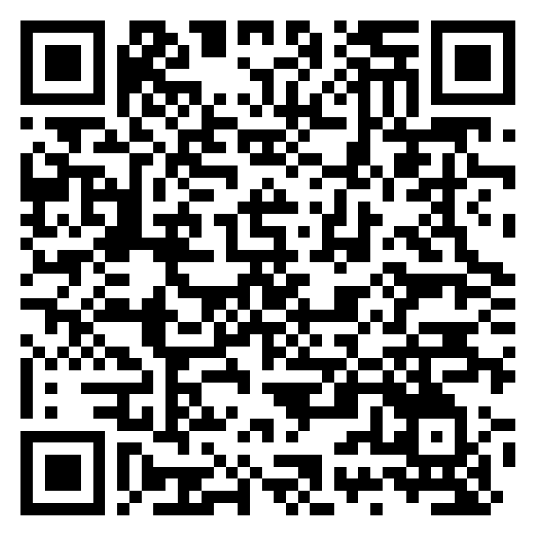
SFFA v. UNC/Harvard (2023)
On June 29, 2023, the U.S. Supreme Court issued its decision in the Students for Fair Admissions v. Harvard/UNC cases regarding the universities’ consideration of an applicant’s racial status as one factor among many in undergraduate admissions to advance their interests in promoting the educational benefits of diversity for all students.
In a consolidated opinion, the Court ruled that institutions could no longer consider racial status to advance the educational benefits of diversity as asserted by Harvard and UNC.
Preliminary Guidance Regarding the U.S. Supreme Court’s Decision in SFFA v. Harvard and SFFA v. UNC
https://rb.gy/cixv1c

Slide 16
The 2023 SCOTUS Ruling in a Nutshell

Slide 17
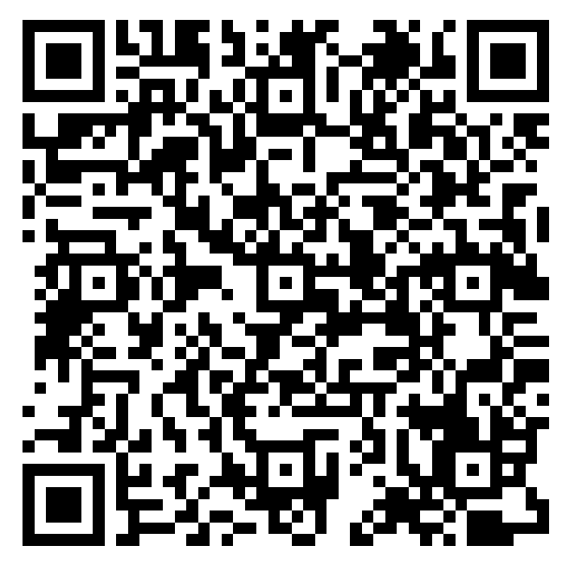
SCOTUS Ruling: Overview
Not Permitted
Racial status cannot be used to advantage or disadvantage a student in the college admissions process.
Permitted
Institutions have the authority to establish their mission including articulating and pursuing institutional diversity goals.
As stated on pages 39-40 in the ruling: "Nothing in this opinion should be construed as prohibiting universities from considering an applicant’s discussion of how race affected his or her life, be it through discrimination, inspiration, or otherwise. ... A benefit to a student who overcame racial discrimination, for example, must be tied to that student’s courage and determination. Or a benefit to a student whose heritage or culture motivated him or her to assume a leadership role or attain a particular goal must be tied to that student’s unique ability to contribute to the university. In other words, the student must be treated based on his or her experiences as an individual — not on the basis of race."
Supreme Court Ruling Overview
tinyurl.com/4hrmz5f6

Slide 18
Additional Ruling Guidance and Insight

Slide 19
How does the ruling impact Native college applicants?
Questions and Answers Regarding the Supreme Court’s Decision [DOJ/DOE Resource]: “As part of their holistic review, institutions may also continue to consider a wide range of factors that shape an applicant’s lived experiences. These factors include but are not limited to financial means and broader socioeconomic status; whether the applicant lives in a city, suburb, or rural area; information about the applicant’s neighborhood and high school; whether the applicant is a citizen or member of a Tribal Nation; family background; parental education level; experiences of adversity, including discrimination; participation in service or community organizations; and whether the applicant speaks more than one language.”
Consider watching/listening to the following clips from the SCOTUS colloquia session at College Board’s Forum in November 2023:
3:20–11:49 (Bottom line/myths about the ruling)
11:50–14:01(Advice for K–12 counselors about the ruling)
18:20–20:18 (Implications of the ruling on institutional goals and values)
20:21–22:11 (Implications of the ruling on recruitment and outreach)
22:12–25:39 (Marathon, not a sprint)

Slide 20
Reflection Questions
How is your institution communicating with and educating K–12 counselors about supporting their students in the admissions process in this new legal framework?
Are you shifting your recruitment and outreach efforts to expand your student pipeline at the top? If so, what strategies may work best for your institution?
What steps is your institution taking toward long-term strategic responses to the ruling?

Slide 21
Resources to Inform Next Steps

Slide 22
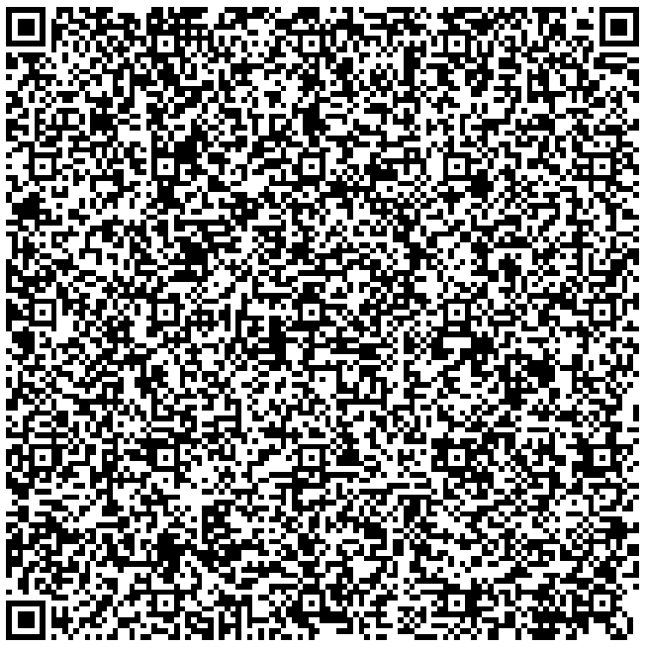
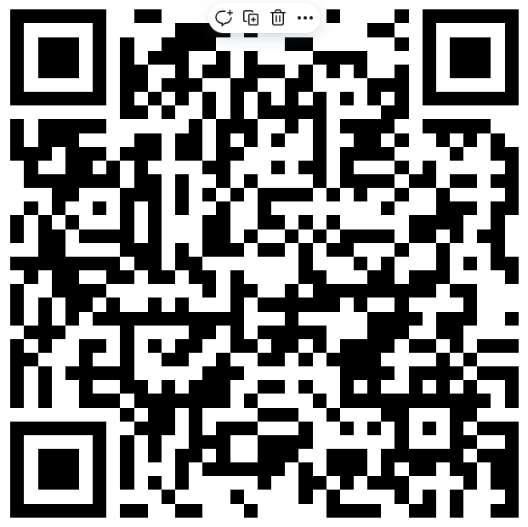
Race and College Admissions: What’s Next? (March 2024)
This webinar explores how institutions can navigate the new legal landscape while operating within the confines of the law. Important questions remain at this pivotal juncture regarding emerging lessons learned and plans for ongoing public and student engagement, particularly concerning the release of new enrollment data. The webinar also offers reflections on emerging trend and implementation insights; strategy recommendations for public engagement in responding to 2024 enrollment data; and an overview of emerging second-generation legal issues and new cases on the horizon that will likely affect the evolving legal landscape of race and college admissions.
Slide 8: Key issues in enrollment
Slides 9–13: ADC SCOTUS survey results
Slide 17: Core values and strategic framing
Slide 19: Release of demographic data
Slide 24: Race neutrality and the law
Webinar Recording
Webinar Slide deck

Slide 23
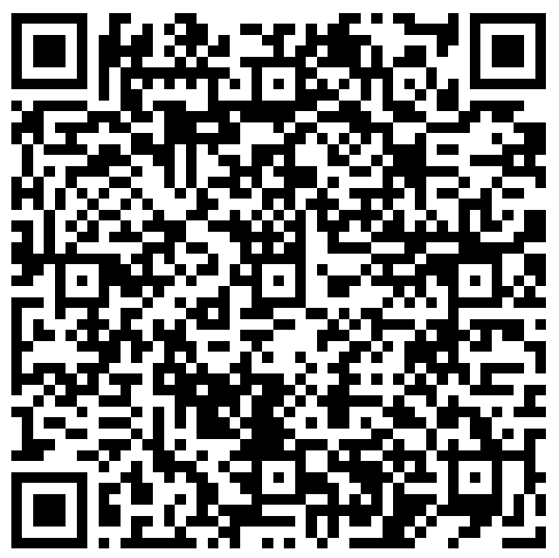
Race Neutral Strategies
Race-Neutral Strategies in a Post-SCOTUS Environment (June 2024)
This webinar discusses the legal and enrollment policy landscape following the Supreme Court’s 2023 SFFA v. Harvard/UNC decision, with a focus on “race-neutral” policies that can advance institutional diversity, equity and inclusion interests. This webinar also previews segments of the 3rd edition of The Playbook: Understanding the Role of Race Neutral Strategies in Advancing Higher Education Diversity Goals, to be released in fall 2024. This resource will provide race-neutral strategies and “plays” higher education institutions can consider as they design and implement enrollment policies, focusing on recruitment, selection, and yield initiatives, as well as models of success.
Slide 6: Implications for race-neutral practice
Slide 9: Anti-DEI legislation
Slides 10–12: Race neutral vs. race conscious
Slide 16: Policy development baselines
Slide 18: Neutral strategies landscape

Slide 24
ADC Sponsor Examples

Slide 25
A selective private institution in the South
This selective private institution in the South typically conducts training in October before reading files in November. Trainings are usually half days with check-in points throughout the year.
The institution has a campus-based team, regional staff throughout the country and outside readers. The campus-based team and regional staff are expected to participate in on-campus training. While virtual training was productive, the institution felt it was better for staff—especially new staff members— to have hard conversations in person.
Zoom is used to train external readers, but the line of communication is always open.
The admissions office participates in the institution’s required (even for students) university-wide bias training.

Slide 26
A public flagship institution in the Northeast
This public flagship in the Northeast conducts its main training in October with permanent staff and seasonal readers, enhanced by periodic touch points. Most training is virtual, with some in-person sessions.
During the 2023–2024 cycle, the school’s general counsel was invited to attend in-person training and implicit bias training.
The most sensitive topics are discussed in person to ensure staff feel comfortable processing the content.
Seasonal readers are required to attend the in-person sessions.
The institution has roughly 25 external readers.
Live virtual training is conducted via Microsoft Teams and the sessions, lasting typically 30 – 60 minutes, are recorded and shared with the staff.

Slide 27
A selective private institution in the Midwest
A selective private institution in the Midwest conducts their file training at the end of October into early November, holding 4–5 half day sessions.
They conduct pre-season training for new admission officers in August before they hit the road.
Legal counsel provides aggregate data on racial status to staff.
All training is held in-person, but it is recorded. Part-time reader training is exclusively virtual.
The team reads in pairs (a professional staff member with another professional or part-time reader) who read activities lists and additional contextual information.
The professional staff conducts academic evaluations, and a committee-based evaluation model is used.

