Slide 1
Post-SCOTUS Staff Training Toolkit
Updated: May 2025

Slide 2
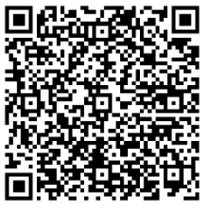
Summary
Following the 2023 SCOTUS ruling, which prohibits considering race in the admissions process, College Board’s Access and Opportunity Collaborative highlighted the need for new resources to support admissions staff training. Eleven higher ed institutions shared their current training practices, and we have distilled the key insights into a practical, action-oriented summary of effective practices. In addition, we have compiled a set of materials requested by institutions as a resource for staff training.
Please Note: Each institution will make their own decisions about the structure and content of their admission training. Institutions should always confer with their legal counsel to ensure they operate within the confines of the law.
Access this
toolkit virtually

Slide 3
Common Actions and Practices

Slide 4
Continuous training on application review and evaluation
01
Continuous Training
Continuous training is essential for effectively reviewing and evaluating applications:
Primary Training: Typically takes place in the fall prior to application reviews. A large flagship public institution noted that they begin training their new admission staff and interns in early summer so they’re already familiar with the information when full staff training starts in fall.
Regular Check-Ins: Establish opportunities throughout the application review season to allow staff to answer questions, identify trends they may be seeing, and ensure everyone is on the same page.
Comprehensive Training Methods: Incorporate homework including mock application review, readings, group work, and a final assessment to ensure thorough understanding.
02
Managing Application Review
03
Anticipate Questions

Slide 5
Determine who gets to view applicants’ racial status and when
01
Continuous Training
There are mixed strategies on whether staff see applicants’ racial status on the application:
State Bans Pre-2023 Ruling: Some ADC sponsor institutions in states with previous bans on race-conscious admission chose to suppress applicants’ racial status on the application.
Post-2023 Ruling: Following the 2023 ruling, other ADC institutions have also decided not to allow staff and readers to see applicants’ racial status during the review process.
Data Collection: The ruling did not specifically address data collection or require institutions to suppress or remove racial status from applications. U.S. Department of Education Post-SFFA guidance advised that suppression of an applicant’s racial status from view of file reviewers and admissions staff involved in selection was warranted.
02
Managing Application Review
03
Anticipate Questions

Slide 6
Be prepared for questions
01
Continuous Training
Questions from staff and their understanding of the ruling may vary based on experience level:
Common Concerns: Many ADC sponsors noticed that the most common questions from staff are centered around correctly following the law while evaluating applications.
Application Review Notes: A highly selective institution in the Midwest shared that many staff grapple with writing notes that don’t appear to consider racial status when students talk about race as part of their live experience within their application materials.
Experience Level Differences: Some ADC sponsors indicated they see a difference in the level of understanding of the ruling from their entry-level and senior staff. For example, a selective mid-Atlantic institution shared that their junior staff often present questions about the “gray area” and the ruling’s impact on the profession, reflecting their developing admission experience. Conversely, a private institution in the South found that seasoned staff presented questions due to their familiarity with previous processes, while newer staff had fewer questions as the application evaluation process was new to them.
02
Managing Application Review
03
Anticipate Questions

Slide 7
Then to Now: A History of Race-Conscious Admission Policies

Slide 8
Four Decades of Legal Precedent
Then to Now: A history of race-conscious admission policies

Slide 9
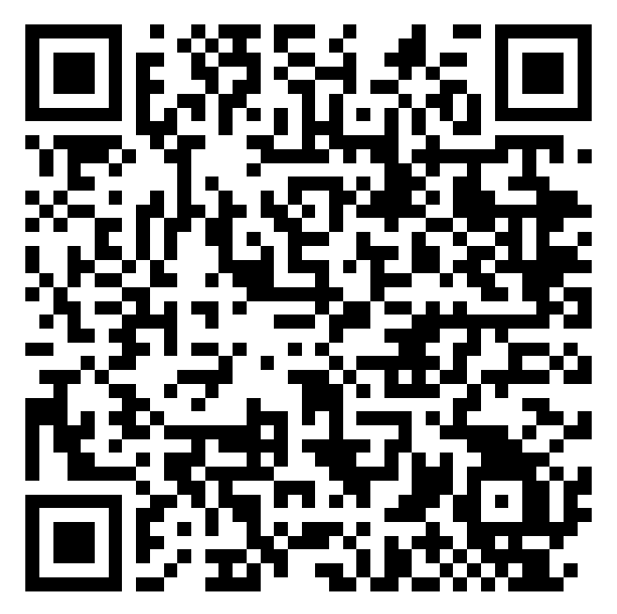
Bakke (1978)
In 1978, the U.S. Supreme Court ruled that the use of quotas for admission purposes was unconstitutional and struck down the University of California Davis’ Medical School admissions policy that provided a set-aside for underrepresented minority students.
At the same time, Justice Powell’s opinion opened the door to institutions being able to consider an applicant’s race as one factor among many to advance diversity interests.
Admissions and Diversity After Michigan: The Next Generation of Legal and Policy Issues
https://rb.gy/065hvf

Slide 10
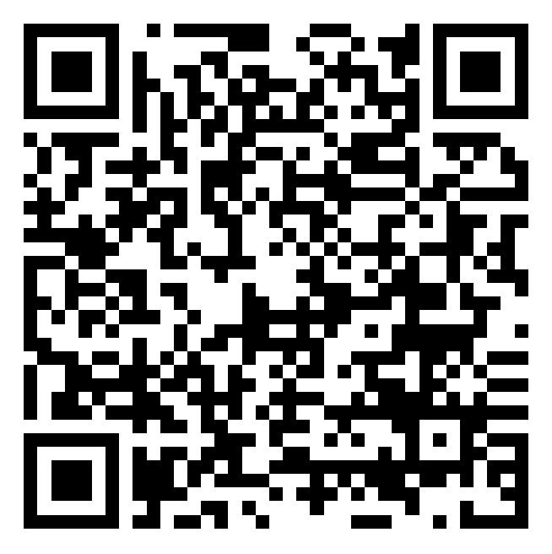
Grutter and Gratz (2003)
In 2003, the United States Supreme Court’s Grutter v. Bollinger and Gratz v. Bollinger decisions affirmed that the educational benefits of diversity could justify limited race- conscious admissions practices and, as a consequence, generated a renewed focus on both the means and ends associated with higher education’s diversity-related goals. The Court upheld the University of Michigan’s law school policy but struck down it’s undergraduate admissions policy in these cases.
When the Supreme Court first ruled on affirmative action
https://rb.gy/yujtpv

Slide 11
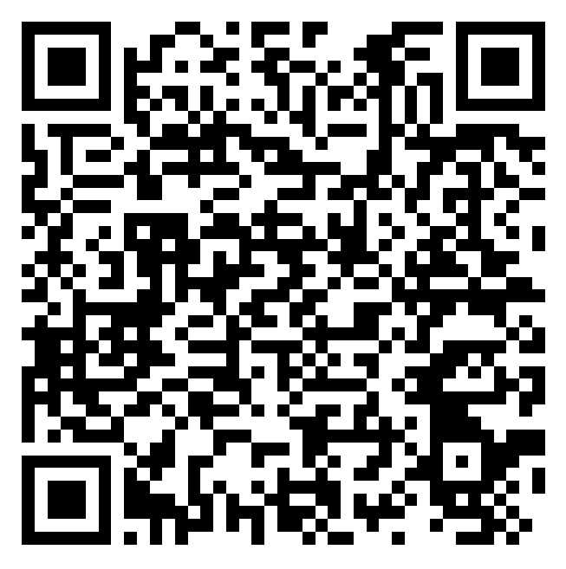
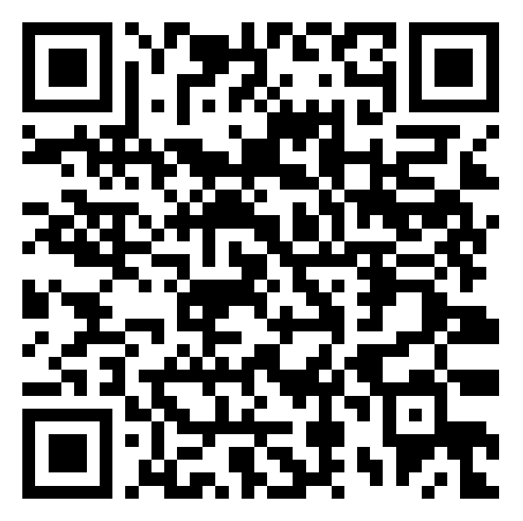
Fisher I and Fisher II (2013, 2016)
On June 23, 2016, the U.S. Supreme Court’s second decision in Fisher v. University of Texas at Austin upheld the University of Texas’s race-conscious admissions program under federal law following a decision that established new requirements regarding race-neutral practices.
Understanding Fisher v. University of Texas
https://rb.gy/vbofsb
Implications from Fisher II
https://rb.gy/4u2bil

Slide 12
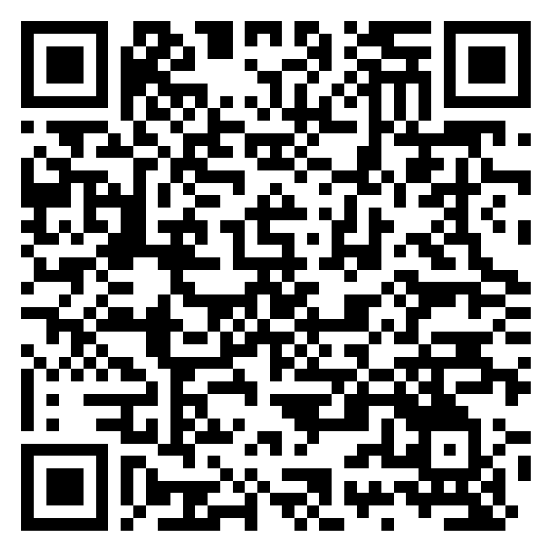
SFFA v. UNC/Harvard (2023)
On June 29, 2023, the U.S. Supreme Court issued its decision in the Students for Fair Admissions v. Harvard/UNC cases regarding the universities’ consideration of an applicant’s race as one factor among many in undergraduate admissions to advance their interests in promoting the educational benefits of diversity for all students.
In a consolidated opinion, the Court ruled that institutions could no longer consider race to advance the educational benefits of diversity as asserted by Harvard and UNC.
Preliminary Guidance Regarding the U.S. Supreme Court’s Decision in SFFA v. Harvard and SFFA v. UNC
https://rb.gy/cixv1c

Slide 13
The 2023 SCOTUS Ruling in a Nutshell

Slide 14
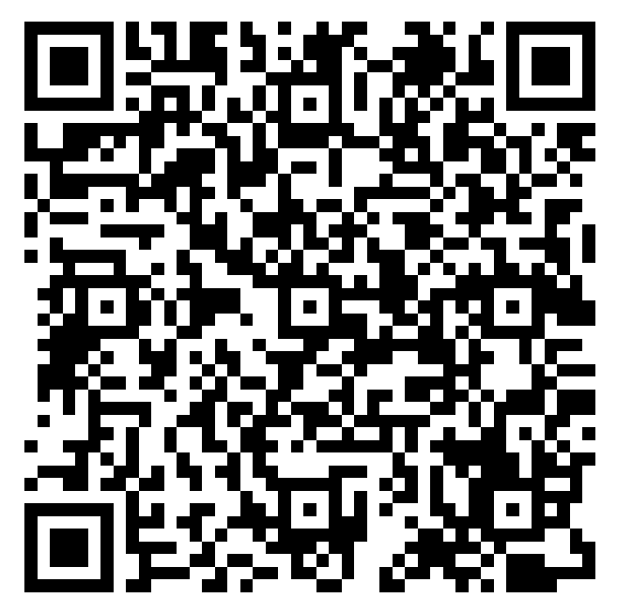
SCOTUS Ruling: Overview
Racial status cannot be used to advantage or disadvantage a student in the college admissions process.
Institutions have the authority to establish their mission, including articulating and pursuing institutional diversity goals. As stated in pages 39-40 in the ruling: "Nothing in this opinion should be construed as prohibiting universities from considering an applicant’s discussion of how race affected his or her life, be it through discrimination, inspiration, or otherwise. ... A benefit to a student who overcame racial discrimination, for example, must be tied to that student’s courage and determination. Or a benefit to a student whose heritage or culture motivated him or her to assume a leadership role or attain a particular goal must be tied to that student’s unique ability to contribute to the university. In other words, the student must be treated based on his or her experiences as an individual — not on the basis of race."
Supreme Court Ruling Overview
tinyurl.com/4hrmz5f6

Slide 15
Collaborative Sponsor Examples

Slide 16
A selective private institution
This institution typically conducts training in October before reading files in November. Trainings are usually half days with check-in points throughout the year.
The institution has a campus-based team, regional staff throughout the country and outside readers. The campus-based team and regional staff are expected to participate in on-campus training. While virtual training was productive, the institution felt it was better for staff—especially new staff members— to have hard conversations in person.
Zoom is used to train external readers, but the line of communication is always open.
The admissions office participates in the institution’s required (even for students) university-wide bias training.

Slide 17
A public flagship institution
This institution conducts its main training in October with permanent staff and seasonal readers, enhanced by periodic touch points. Most training is virtual, with some in-person sessions.
During the 2023–2024 cycle, the school’s general counsel was invited to attend in-person training and implicit bias training.
The most sensitive topics are discussed in person to ensure staff feel comfortable processing the content.
Seasonal readers are required to attend the in-person sessions.
The institution has roughly 25 external readers.
Live virtual training is conducted via Microsoft Teams and the sessions, lasting typically 30 – 60 minutes, are recorded and shared with the staff.

Slide 18
A selective private institution
This institution conducts their file training at the end of October into early November, holding 4–5 half day sessions.
They conduct pre-season training for new admission officers in August before they hit the road.
Legal counsel provides aggregate data on race to staff.
All training is held in-person but it is recorded. Part-time reader training is exclusively virtual.
The team reads in pairs (a professional staff member with another professional or part-time reader) who read activities lists and additional contextual information.
The professional staff conducts academic evaluations, and a committee-based evaluation model is used.

Slide 19
Resources
Please note: The resources, information, and any analyses in the Archive are likely to have been superseded by more recent rulings and guidance provided by federal and state governments. Institutions should not consider any of the content as legal advice and should work closely with their legal counsel to understand the most recent guidance.
Preliminary Guidance Regarding the U.S. Supreme Court’s Decision in SFFA v. Harvard and SFFA v. UNC (July 2023)
Webinar: The Shifting Landscape: Navigating the Supreme Court’s Decision on Race in College Admissions (July 2023) Passcode: access2023!
Resource for K12 School Leaders: Understanding the Supreme Court’s Ruling (February 2024)
In February 2025, the Office for Civil Rights issued the Dear Colleague Letter directing colleges and universities to eliminate the consideration of race in scholarships and other campus programs and activities. As follow up to the DCL, the U.S. Department of Education released a set of FAQs in March 2025 to answer questions that may arise from the DCL.
You can find a collection of prior resources in the Case Analyses & Guidance Archive.

