Slide 1
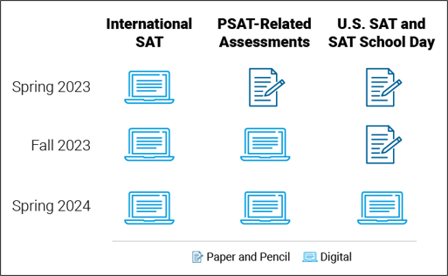
<Insert College Name> will use the SAT administered digitally in the same way it currently uses the SAT.
What will digital SAT® mean for students and schools?
The test will be shorter (two hours not three).
Scores will be available more quickly for students who submit them.
Flexibility will increase for schools with less instructional time lost.
Students can use their own device, use a school-issued device, or request to borrow one from College Board.
Access will be expanded with more international administrations immediately.
Security will be significantly enhanced.
For students testing internationally, juniors in the high school class of 2024 will be the first to take the digital SAT.
In the U.S., students in the high school class of 2025 will be the first class to take the digital test.
Notes:
Pull supportive text from the final version of the for Notes

